Slide 1
Stanford ME469: Common low-Mach Discretization Approaches: CVFEM/FEM
Stefan P. Domino
Computational Thermal and Fluid Mechanics
Sandia National Laboratories SAND2018-4536 PE

Slide 2
Deep Dive on CVFEM
Recall, CVFEM is a discretization scheme that:
Iterates over locally-owned elements for Time/Source/etc. (volumetric-based terms)
Iterates over locally-owned elements for Advection/Diffusion/etc. (integrated by parts terms)
Below is the patch of elements connected to node 2 (a global matrix row number)
8
5
6
Note: Time and source terms can also be evaluated at nodes without loss of accuracy
1
2
3
7
4
Sample patch of elements

Slide 3
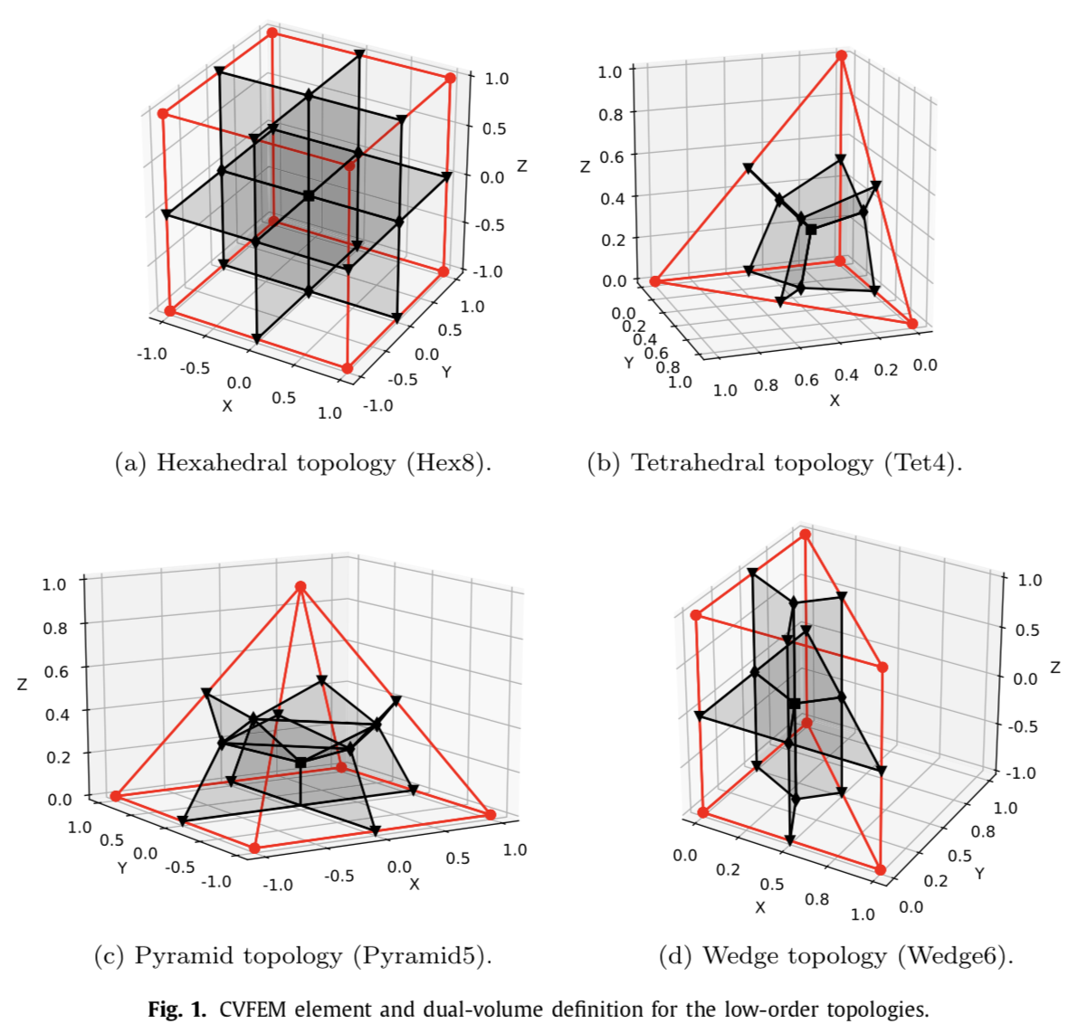
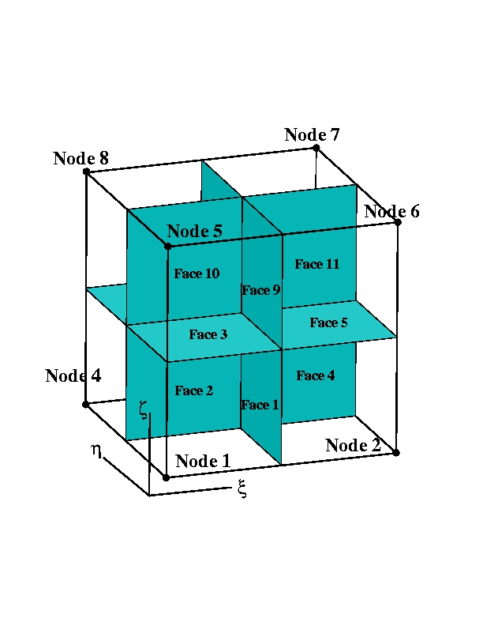
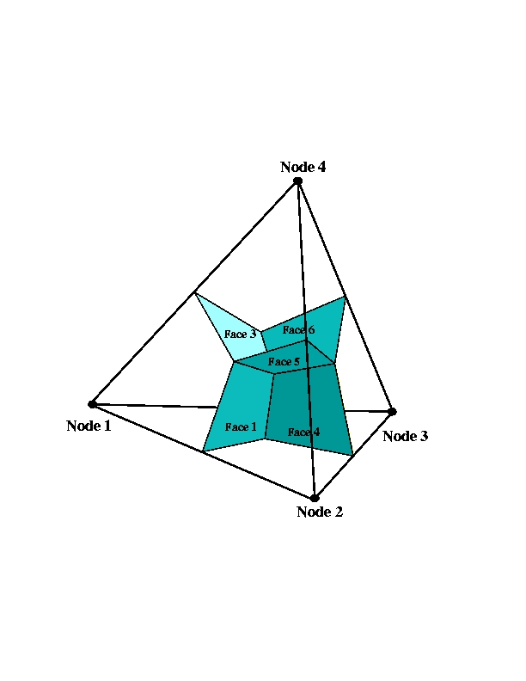
Dual Volume Definitions for Hybrid Meshes
Domino, et. al, “An assessment of atypical mesh topologies for low-Mach large-eddy simulation” 2019

Slide 4
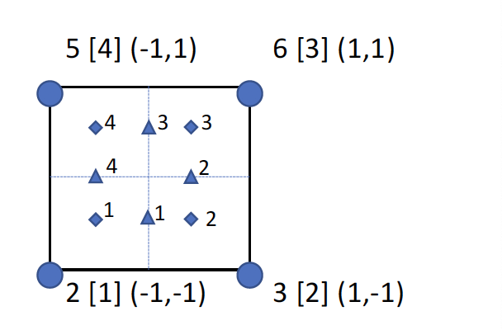
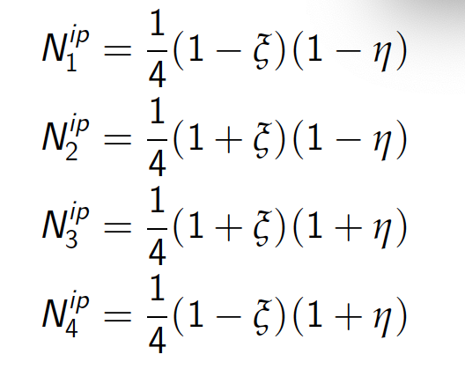
Deep Dive on CVFEM: Element-loops
For each element, recall that a dual volume has been constructed
Volume-based contributions are evaluated at the subcontrol volume integration points (diamonds)
Surface-based contributions are evaluated at the subcontrol surface integration points (triangles)
We define an isoparametric element than ranges from -1:1 in the ξ− (x-direction) and η− (y-direction) direction
Basis Functions for a Quad4
For example, the isoparametric coordinate for ip 1 is (0.0, -0.5)

Slide 5
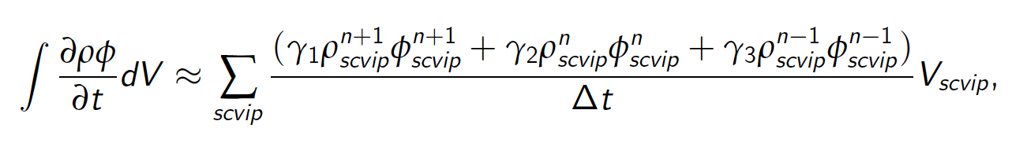
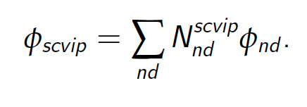
Deep Dive on CVFEM: Implicit Time Discretization
Backward Euler (two state) and is first-order accurate (A-stable)
BDF2 (three state) is second-order accurate (A-stable)
This term is assembled over an element iteration and drives a consistent mass matrix with a full node:element:node connectivity
For uniform time steps:
γ₁ = 3/2
γ₂ = -2
γ₃ = 1/2

Slide 6
Deep Dive on CVFEM: Implicit Time Discretization
Backward Euler (two state) and is first-order accurate (A-stable)
BDF2 (three state) is second-order accurate (A-stable)
This term is assembled over an element iteration and drives a consistent mass matrix with a full node:element:node connectivity
Integration points can also be evaluated at the node for a lumped mass matrix
For uniform time steps:
γ₁ = 3/2
γ₂ = -2
γ₃ = 1/2

Slide 7
Deep Dive on CVFEM: Implicit Time Discretization (Code)
https://github.com/NaluCFD/Nalu/blob/master/src/kernel/ScalarMassElemKernel.C
L
C
Convecting Taylor Vortex analytical solution; error computed at 1 second

Slide 8
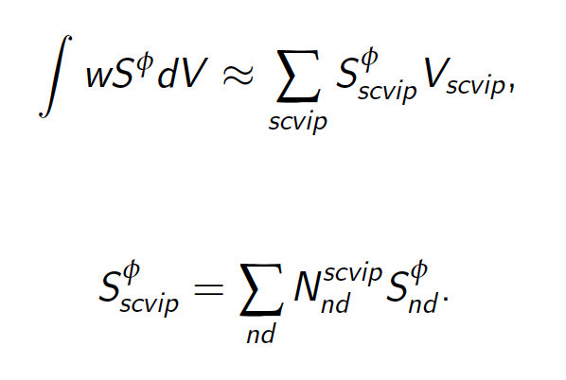
Deep Dive on CVFEM: Source Term Discretization
Source terms for CVFEM are also assembled over an element or nodal loop
In some cases, the source term is complex, i.e., includes gradients, which drives either a nodal assembly of these quantities to the nodes or local evaluation

Slide 9
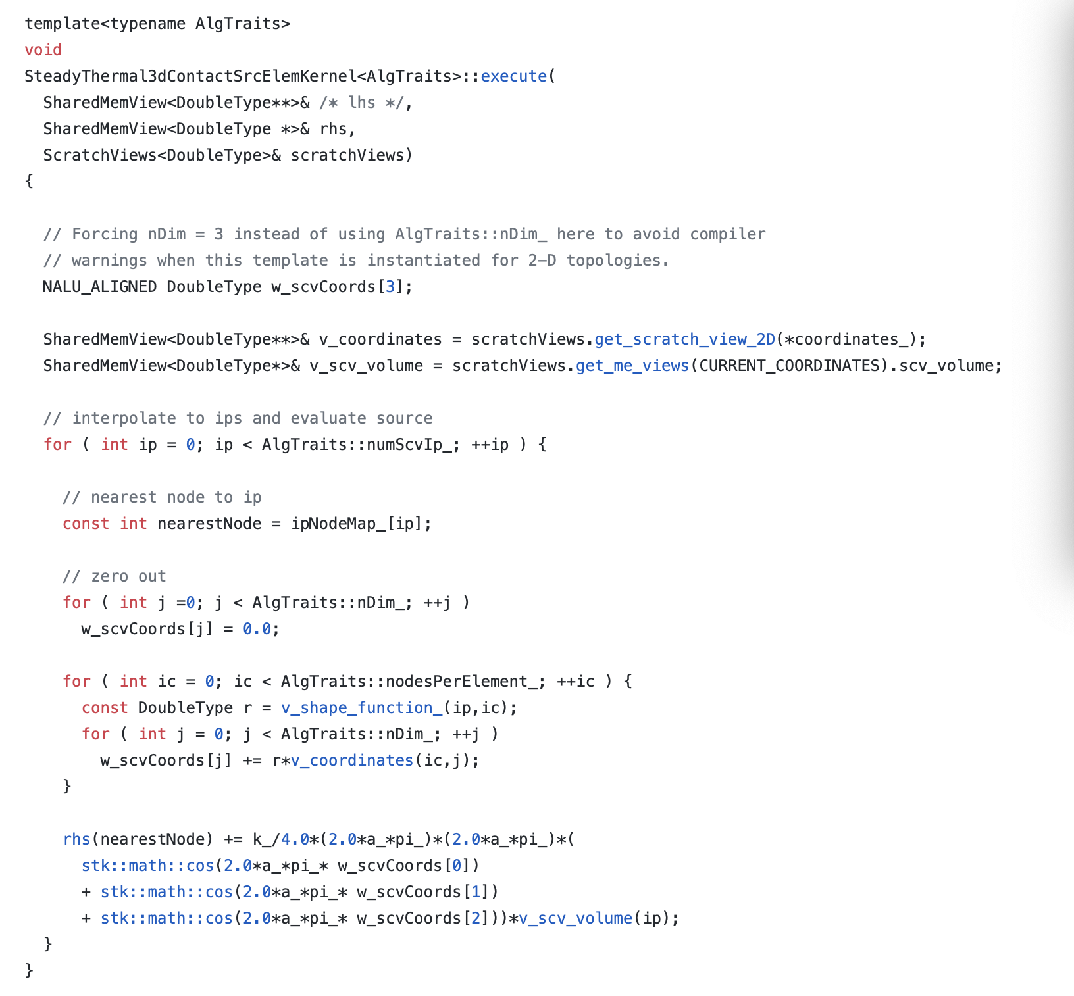
Deep Dive on CVFEM: Source Term Discretization (Code)
https://github.com/NaluCFD/Nalu/blob/master/src/user_functions/SteadyThermal3dContactSrcElemKernel.C

Slide 10
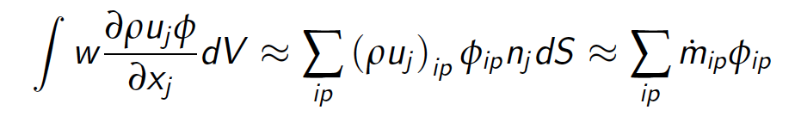
Deep Dive on CVFEM: Advection Discretization (no stabilization)
For advection, we have transformed the volume integral to a surface integration
Therefore, a patch of elements are required for the full assembly at node 2
Recall, that the mass flow rate at an integration point is prescribed
Integration points can also be shifted from the subcontrol surface to the edge mid-poiny (while still using the integration point area vector)
This is a central- or Galerkin-based advection operator
Note:
Common to integrate-by-parts, however, not required
Advection term need not be in divergence form (non-conserved form is suitable)

Slide 11
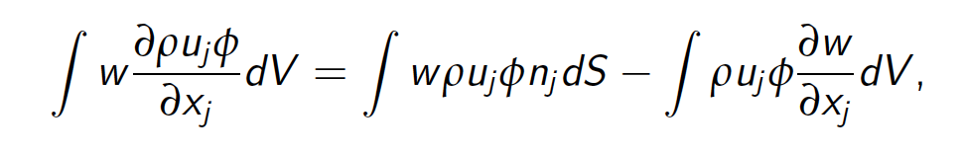
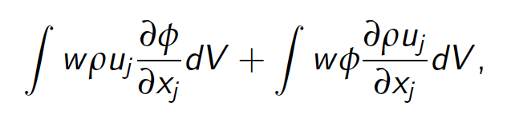
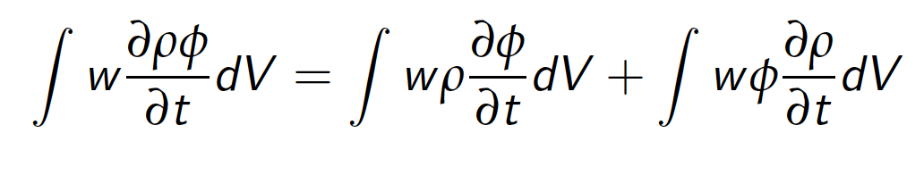
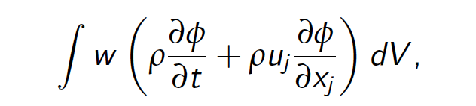
Deep Dive on CVFEM: Advection Discretization Non-Conserved Form
The advection term can be integrated by parts, or not; moreover, the PDE can drive a non-conservative equation form
IBP – or not…
This is now a choice
Non-conserved form, unlike cell-centered FV, poses no complexity

Slide 12
Deep Dive on CVFEM: Advection Discretization (Code)
https://github.com/NaluCFD/Nalu/blob/master/src/kernel/ScalarAdvDiffElemKernel.C
This routine includes advection and diffusion
Recall that integration point value is provided by nodal loop over the underlying nodal basis for this element
Also note that this routine is valid for all types of supported elements – both low- and higher-order
Basis Functions for a Quad4

Slide 13
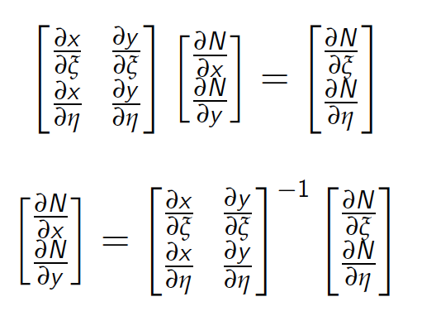
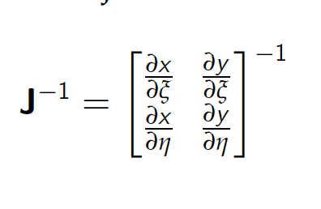
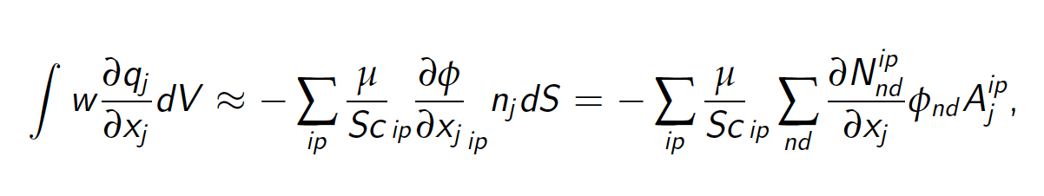
Deep Dive on CVFEM: Diffusion Discretization
For diffusion, we have transformed the volume integral to a surface integration
Therefore, a patch of elements are required for the full assembly at node 2
Note that the CVFEM approach is absent any non-orthogonality corrections;
However, high aspect ratio elements are now challenging…

Slide 14
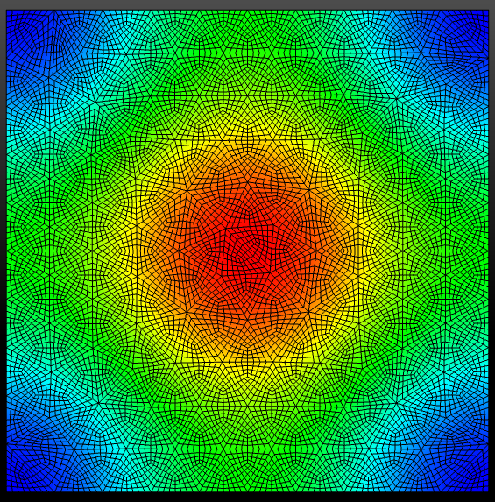
Deep Dive on CVFEM: Diffusion Discretization (code)
https://github.com/NaluCFD/Nalu/blob/master/src/kernel/ScalarAdvDiffElemKernel.C
Manufactured solution for Laplace system on TQuad4

Slide 15
Deep Dive on FEM
Recall, FEM is a discretization scheme that:
Iterates over locally-owned elements for Time/Source/etc (volumetric-based terms)
Iterates over locally-owned elements for Advection/Diffusion/etc. (integrated by parts terms)
Below is the patch of elements connected to node 2 (a global matrix row number)
8
5
6
Note: Single integration point location for all terms
1
2
3
7
4
Sample patch of elements

Slide 16
Deep Dive on FEM: Element-loops
For each element, we have a set of integration or quadrature points (no dual-notion)
We define an isoparametric element than ranges from -1:1 in the ξ− (x-direction) and η− (y-direction) direction
Gaussian quadrature on a -1:1 range is defined, +/- sqrt(3)/3
Basis Functions for a Quad4
5 [4] (-1,1)
6 [3] (1,1)
4
3
1
2
1
2
2 [1] (-1,-1)
3 [2] (1,-1)

Slide 17
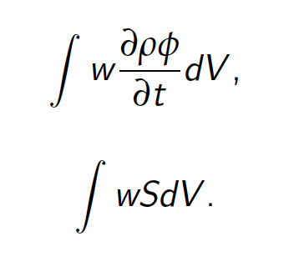
Deep Dive on FEM: Implicit Time Discretization
Backward Euler (two state) and is first-order accurate (A-stable)
BDF2 (three state) is second-order accurate (A-stable)
This term is assembled over an element iteration and drives a consistent mass matrix with a full node:element:node connectivity
For uniform time steps:
γ₁ = 3/2
γ₂ = -2
γ₃ = 1/2
5 [4] (-1,1)
6 [3] (1,1)
4
3
1
2
1
2
2 [1] (-1,-1)
3 [2] (1,-1)

Slide 18
Deep Dive on FEM: Source Term Discretization
Source terms for FEM are assembled over an element loop
In some cases, the source term is complex, i.e., includes gradients, which drives either a nodal assembly of these quantities to the nodes or local evaluation
5 [4] (-1,1)
6 [3] (1,1)
4
3
1
2
1
2
2 [1] (-1,-1)
3 [2] (1,-1)

Slide 19
Deep Dive on FEM: Advection Discretization
Advection terms for FEM are assembled over an element loop
The advection term can be integrated by parts, or not; moreover, the PDE can drive a non-conservative equation form
IBP – or not…
This is now a choice
5 [4] (-1,1)
6 [3] (1,1)
4
3
1
2
1
2
2 [1] (-1,-1)
3 [2] (1,-1)
Non-conserved form, like CVFEM, poses no complexity

Slide 20
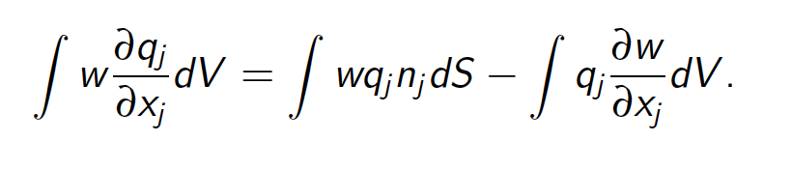
Deep Dive on FEM: Diffusion Discretization
For diffusion, we will again use the nodal basis to support a diffusion operator
Integration-by-parts is desired to remove the second-derivative requirement that would not be possibly for a linear basis
5 [4] (-1,1)
6 [3] (1,1)
4
3
1
2
1
2
2 [1] (-1,-1)
3 [2] (1,-1)
Note that the FEM approach is absent any non-orthogonality corrections

Slide 21
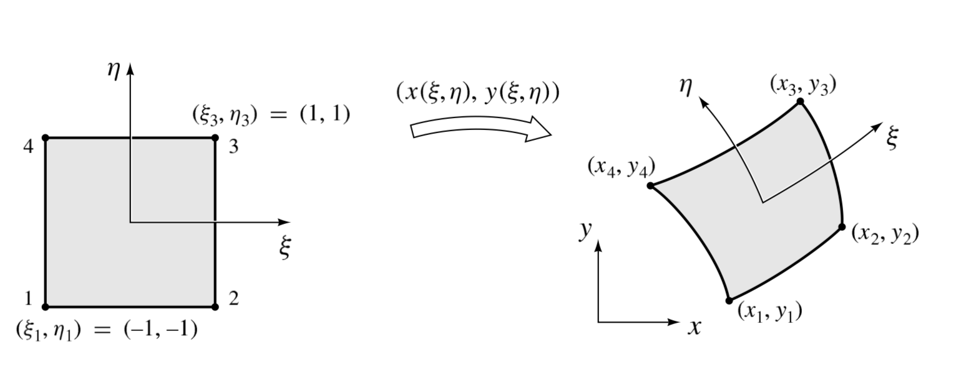
Element Integration: Physical to Transformed Space
Let us define a linear basis over a representative two-dimensional quadrilateral with iso-parametric range of ξ: -1:+1 and η: -1:+1
Goal: Evaluate an integral:
Change of variables:
Transformation:
|J| is determinant of the transformation matrix
With weight w_{g}

Slide 22
Deep Dive on FEM: Discretization Kernels (Code)
Time
https://github.com/NaluCFD/Nalu/blob/master/src/kernel/ScalarMassFemKernel.C
Advection
https://github.com/NaluCFD/Nalu/blob/master/src/kernel/ScalarAdvFemKernel.C
Diffusion
https://github.com/NaluCFD/Nalu/blob/master/src/kernel/ScalarDiffFemKernel.C

Slide 23
Common low-Mach Discretization Approaches: Conclusions
FEM provides a machinery to provide accurate discretizations on non-ideal meshes, however, the same diffusion operator suffers on high-aspect ratio meshes
CVFEM is a hybrid method that contains the likeable attributes of both FV and FEM (same high-aspect ratio diffusion operator finding)

Slide 24
Stanford ME469: Common low-Mach Discretization Approaches: Comparisons
Stefan P. Domino
Computational Thermal and Fluid Mechanics
Sandia National Laboratories SAND2018-4536 PE

Slide 25
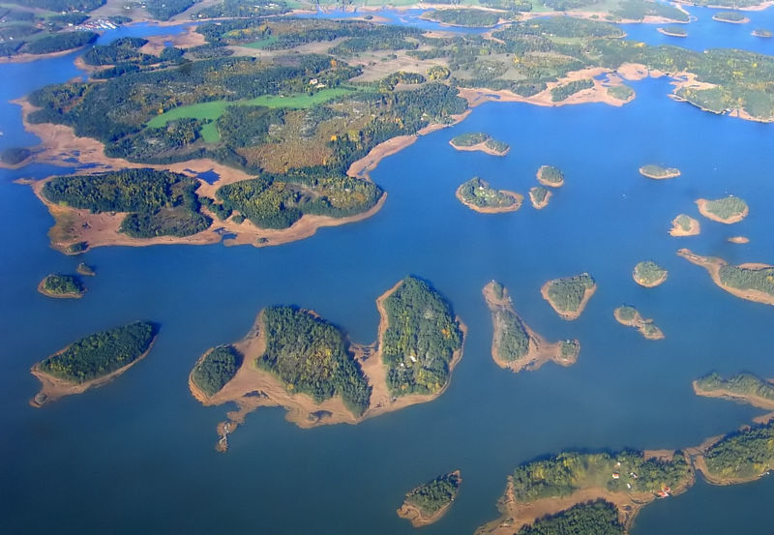
Philosophy: Bridges, not Walls
Me469 Tenant: Let’s work to understand how each method relate to one another
FVM
CVFEM
FD
GFEM

Slide 26
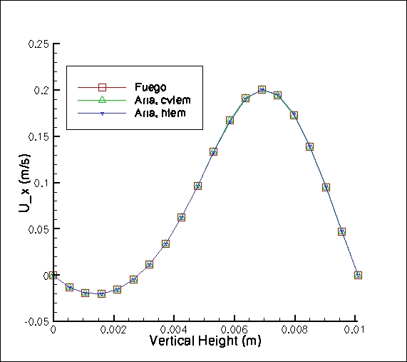
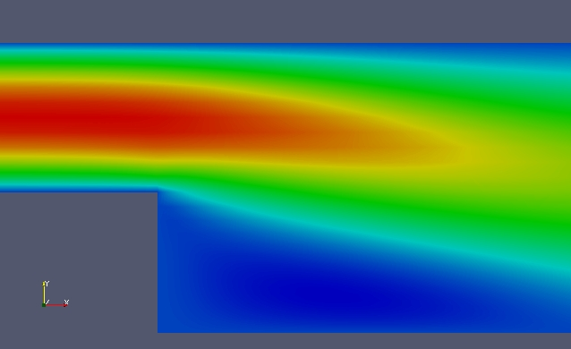
Laminar Backstep
Laminar back step (Re = 389 based on step height) comparing two code implementations for CVFEM (Sierra/Fuego and Sierra Aria), FEM (within Aria – here termed, “hybrid” FEM, or HFEM – essentially, the same low-Mach CVFEM approach with full integration-by-parts).
X-component of velocity
Vertical line represents one-D
line plot location

Slide 27
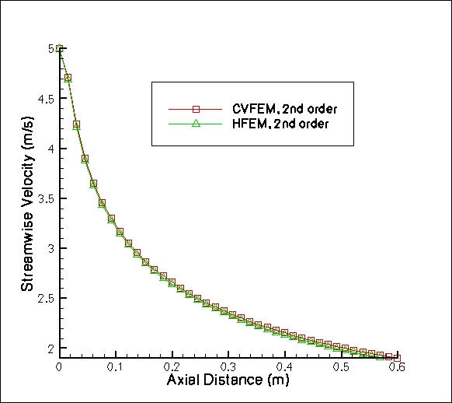
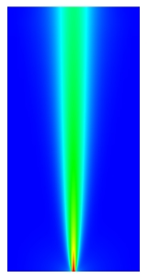
Laminar Jet
Y-component of velocity

Slide 28
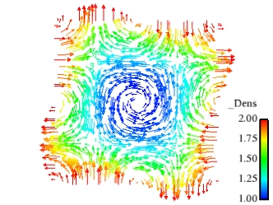
Order-of-Accuracy
Difficult two dimensional variable density low-Mach flow using method of manufactured solutions; DOFS: u, v, p and Z; density = f(Z)
FEM
CVFEM

Slide 29
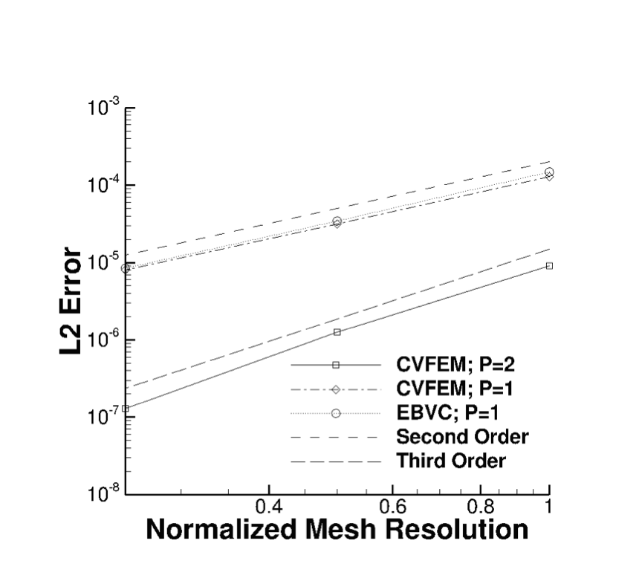
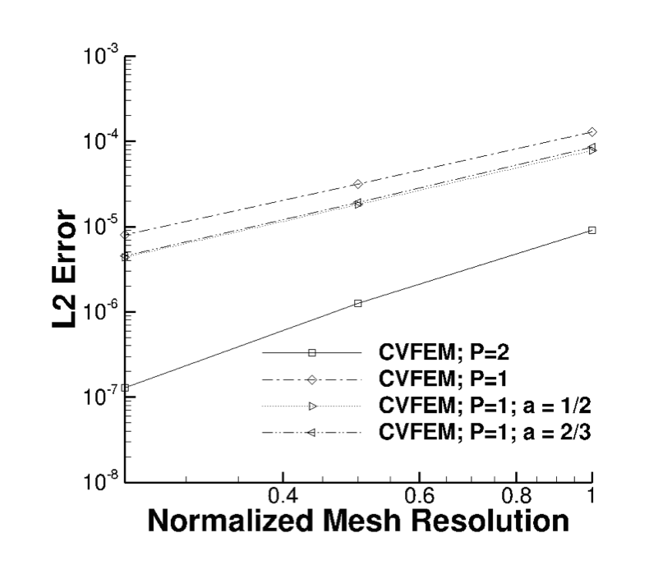
Isothermal Taylor-Vortex Decay
Exercising the low-and high-order (P=1 and P=2 CVFEM) along with EBVC with and without pseudo-higher-order upwind)
Domino, 2014 “A comparison between low-order and higher-order low-Mach discretization approaches”, Proceedings of CTR Summer Program.

Slide 30
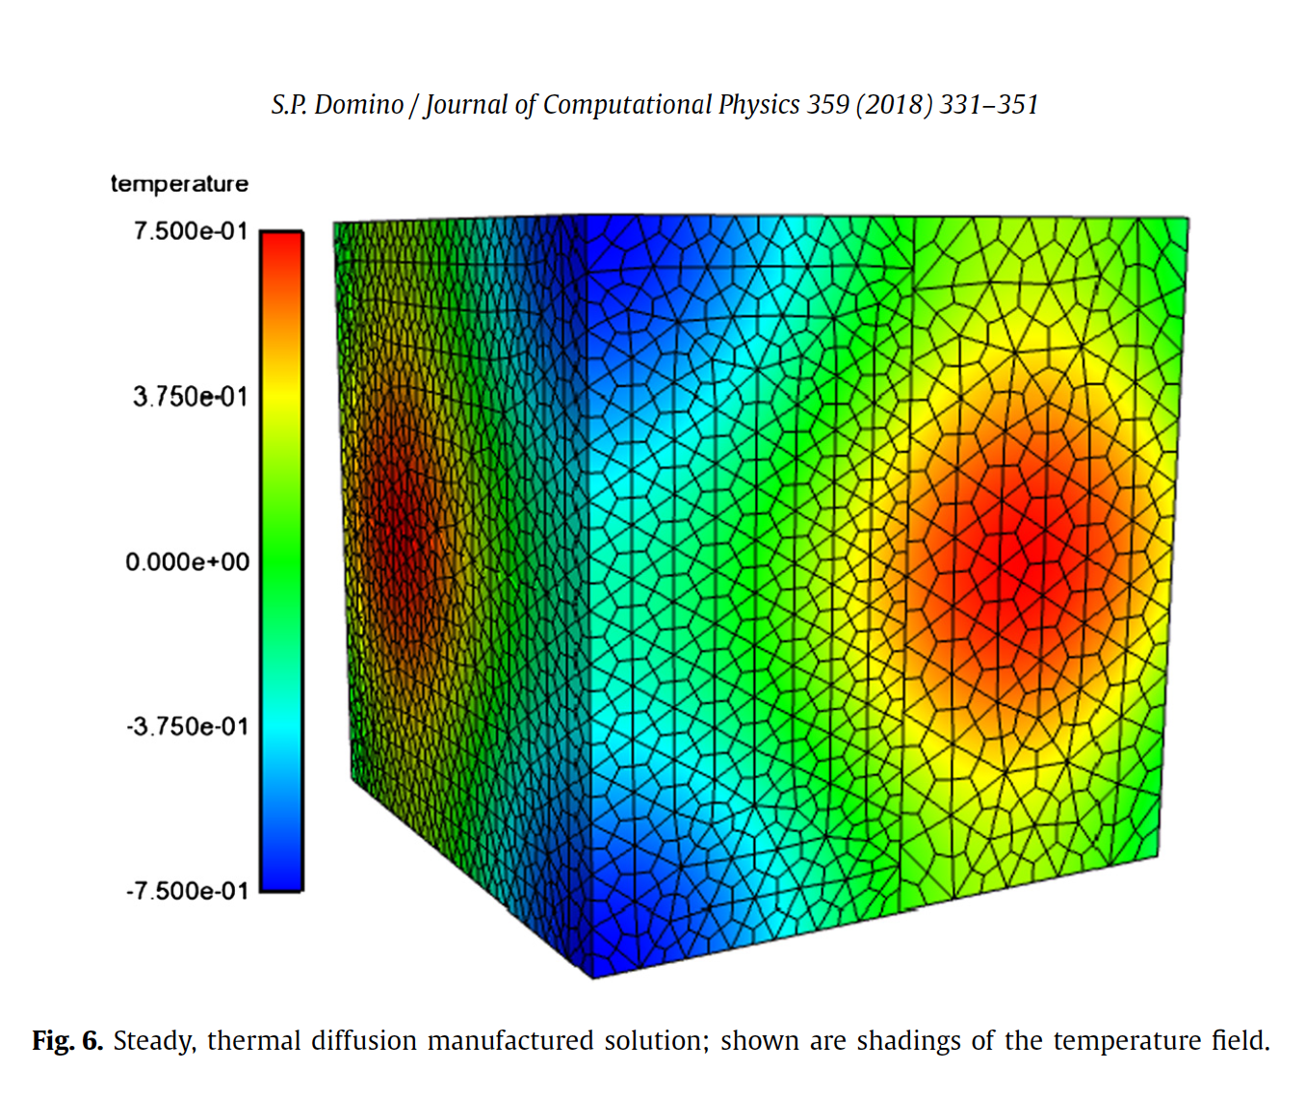
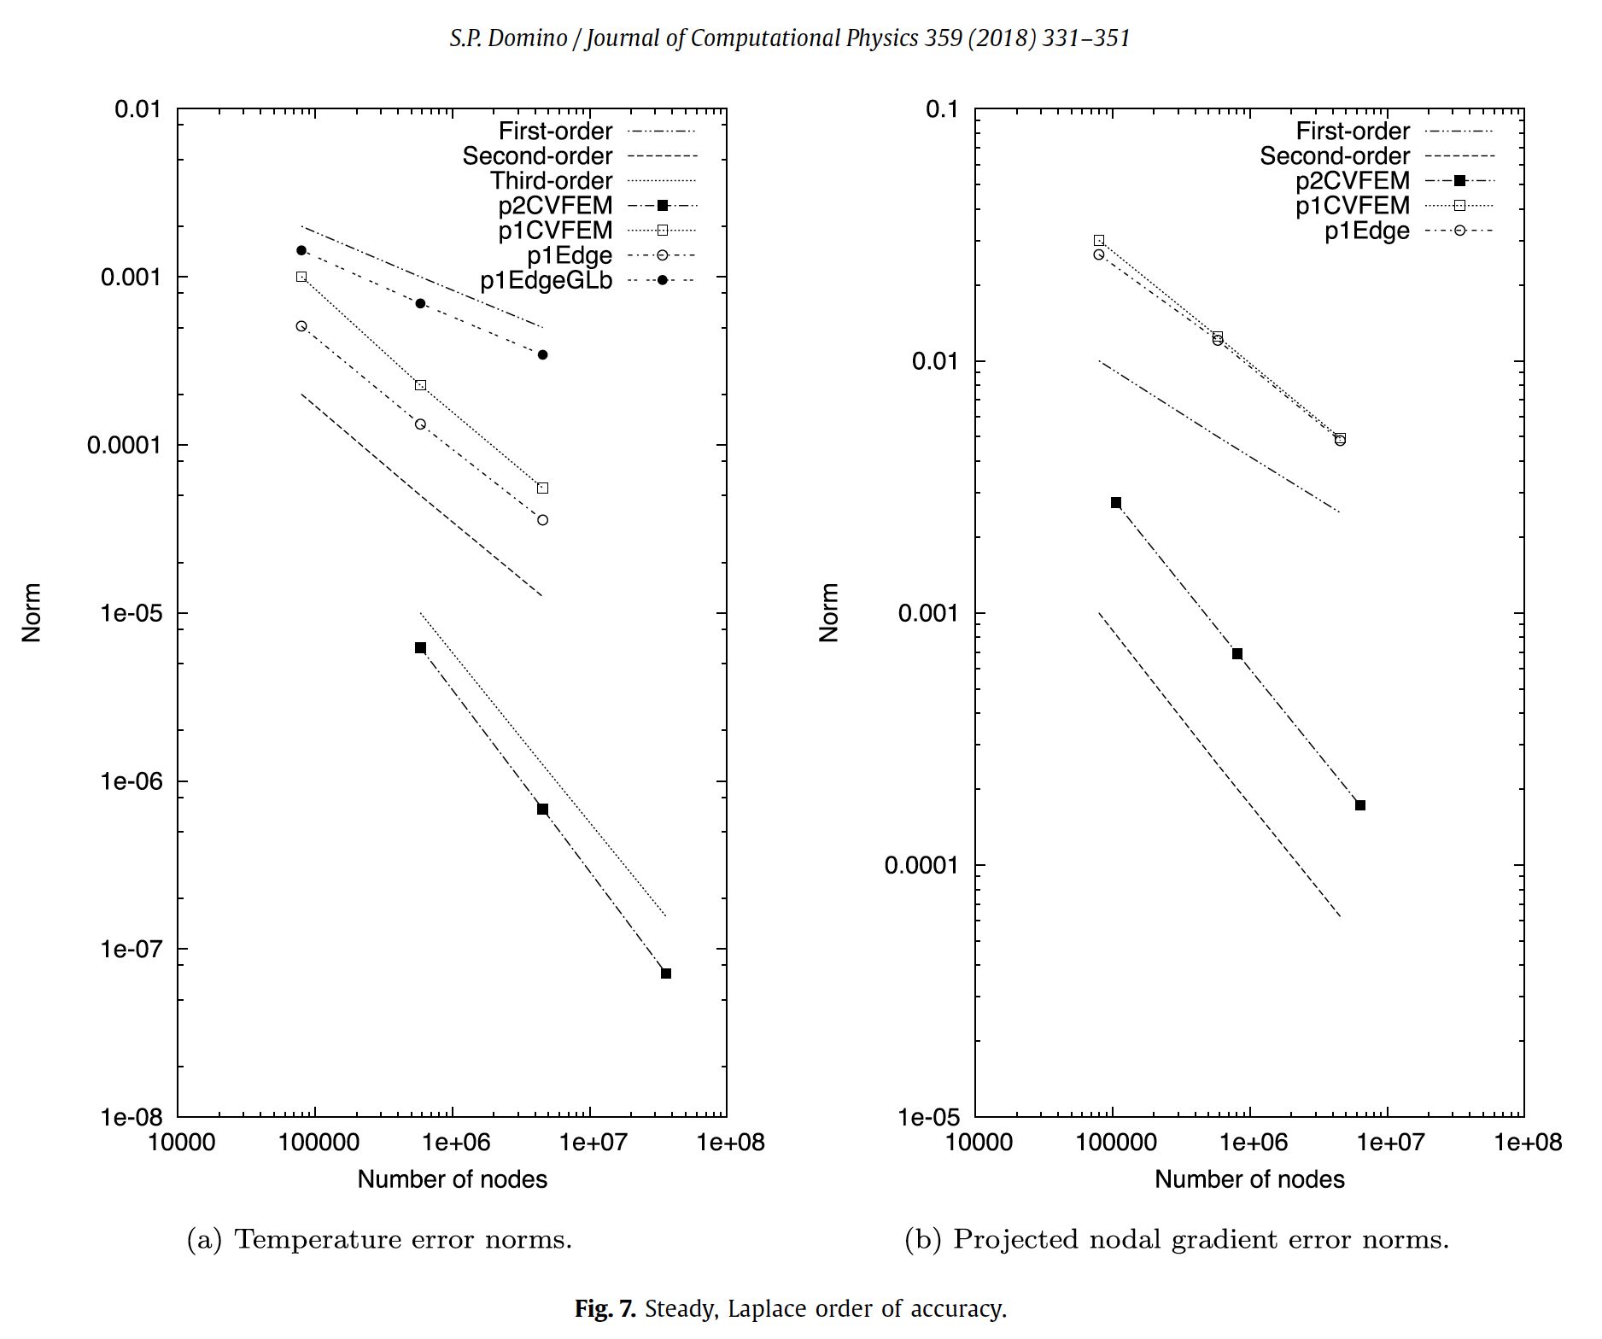
Non-Conformal Laplace Verification

Slide 31
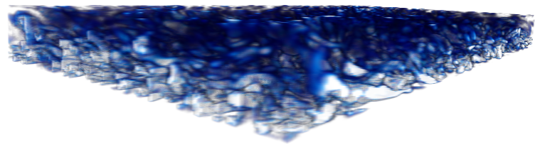
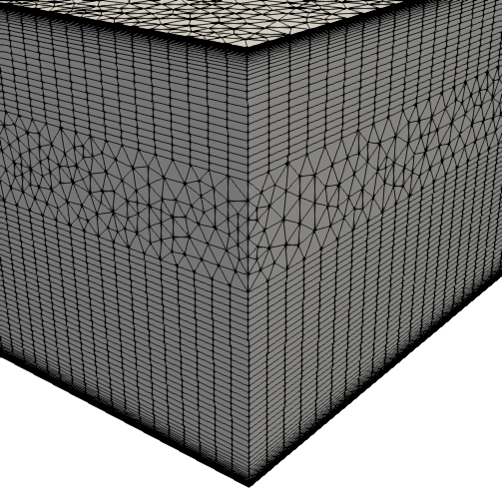
Hybrid Meshes, Even for LES!
Hybrid mesh study based on Ham and Iaccarino, CTR Annual Brief, 2006, found that simulations were extremely sensitive to mesh topology
Non-symmetric time mean flow found for cell-centered; better for the CTR node-centered formulation
Native CVFEM and EBVC are both symmetric in mean quantities
T
B
Domino, et. al, “The suitability of hybrid meshes for low-Mach large-eddy simulation” Stanford CTR Summer Program, 2018

Slide 32
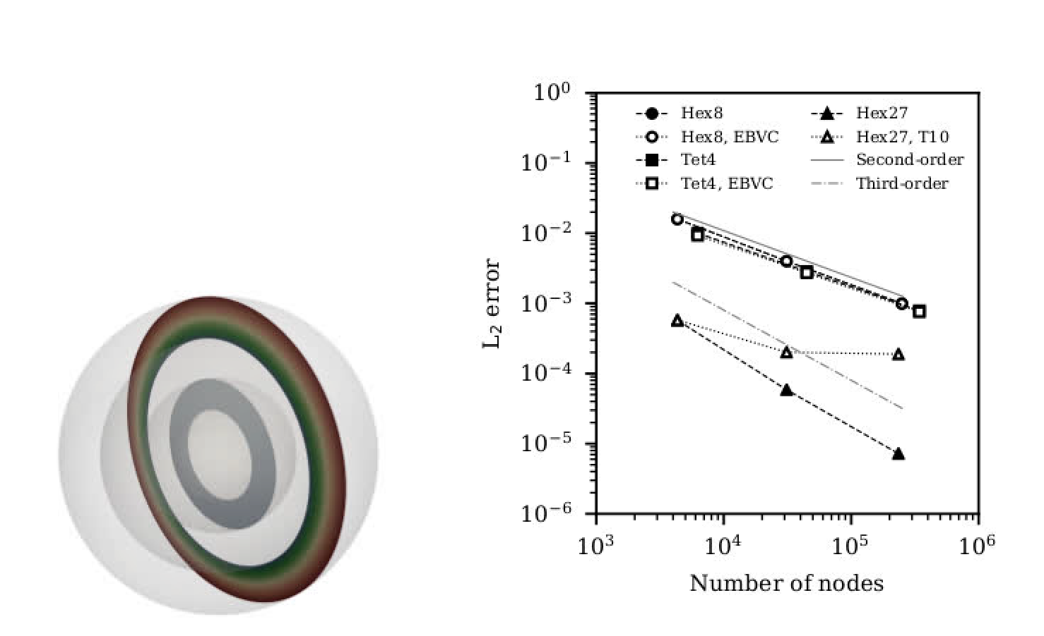
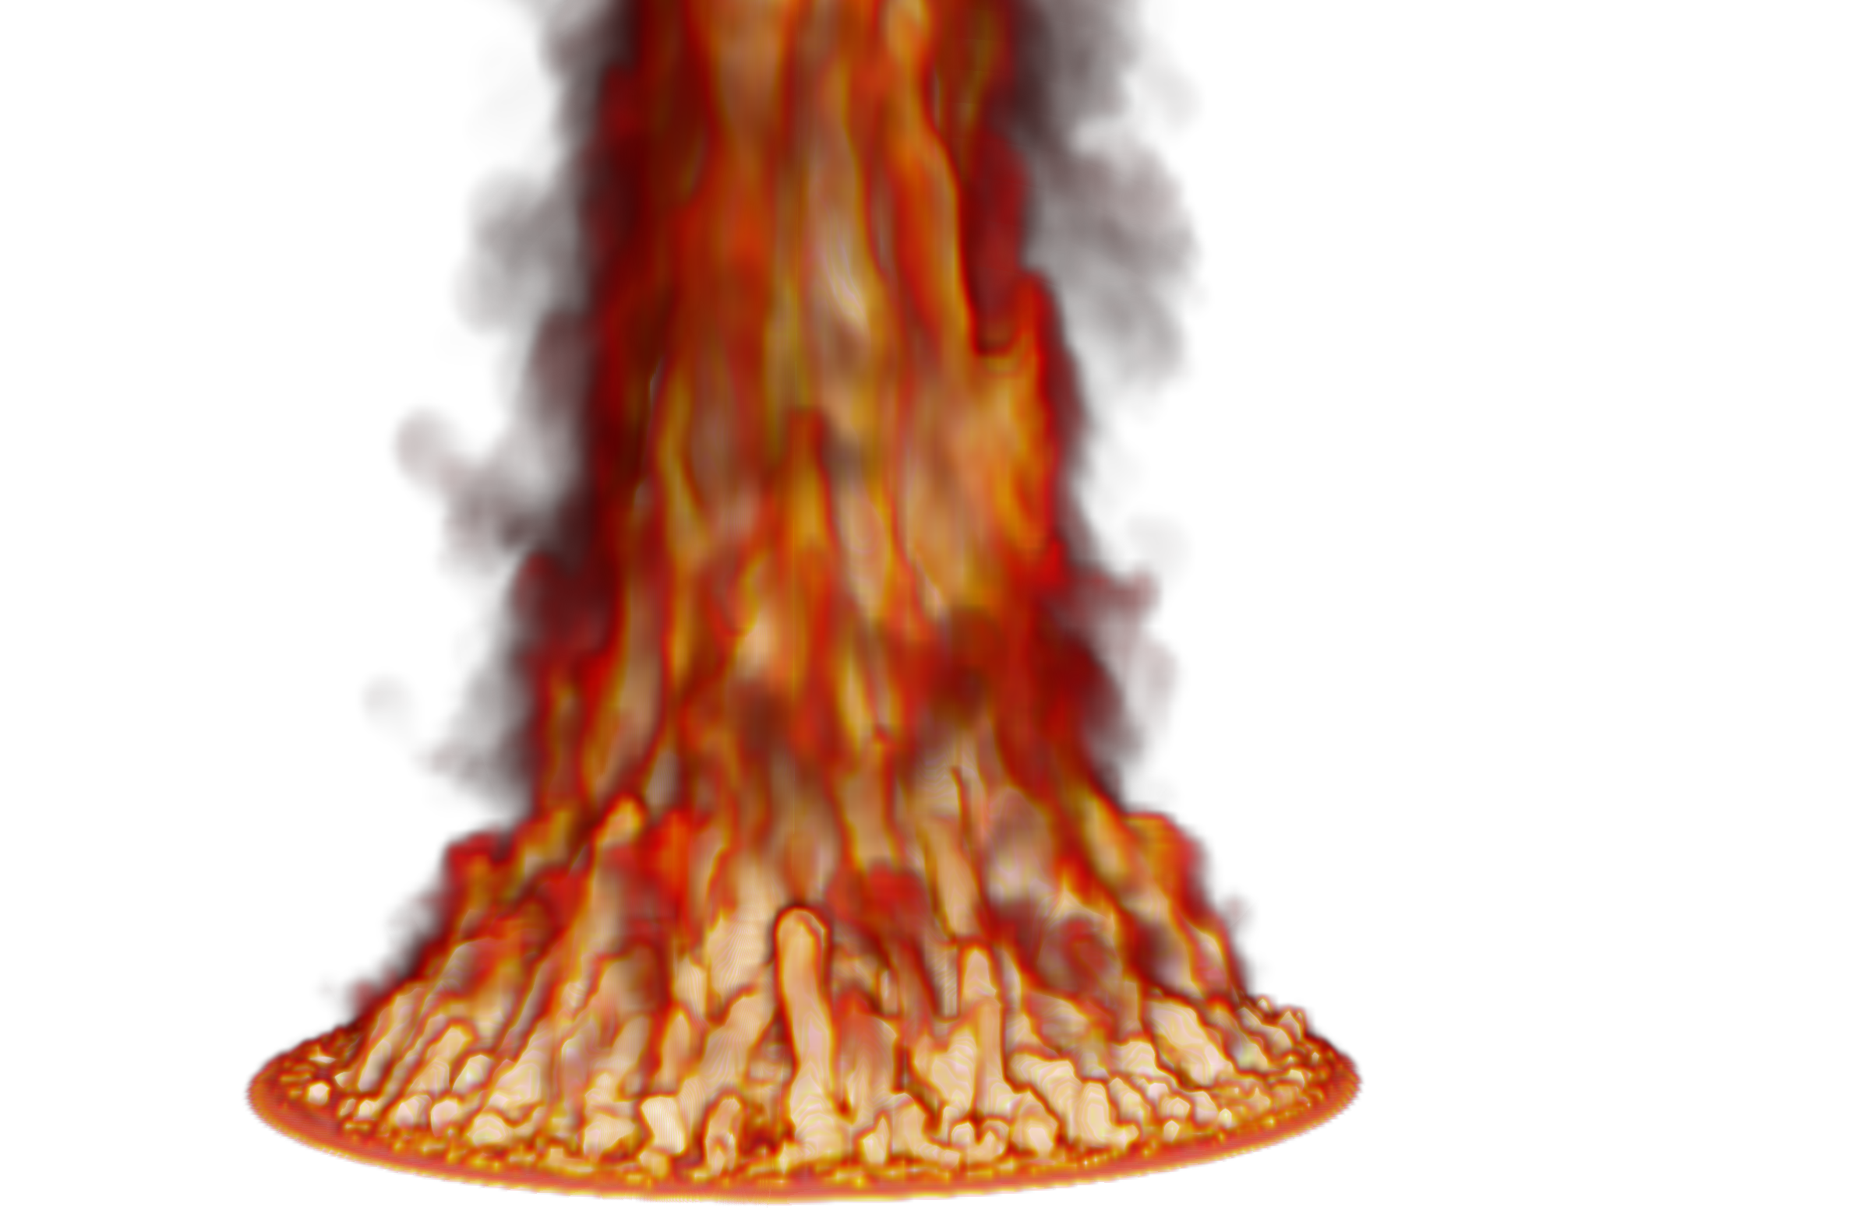


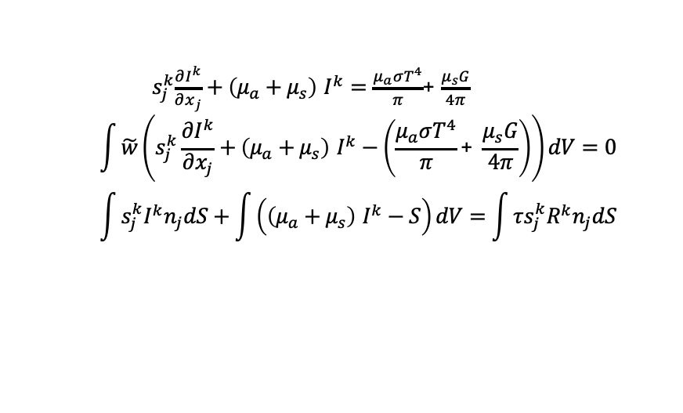
5m JP-8 Pool Fire Validation
Novel participating media radiation solver verification (Tet4, Hex8, Hex27): EBVC and CVFEM, however, based on Streamwise Upwind Petrov Galerkin (SUPG), Burns, 1997
1.7m
${ s}_{j}^{k}\frac{∂I^{k}}{∂x_{j}}+\left(μ_{a}+μ_{s}\right)$ $I^{k}=\frac{μ_{a}σT^{4}}{π}$+ $\frac{μ_{s}G}{4π}$
$$\int{\tilde{w}\left(s_{j}^{k}\frac{∂I^{k}}{∂x_{j}}+\left(μ_{a}+μ_{s}\right) I^{k}−\left(\frac{μ_{a}σT^{4}}{π}\text{+} \frac{μ_{s}G}{4π}\right)\right)}dV=0$$
$$\int{s_{j}^{k}I^{k}n_{j}dS+\int{\left(\left(μ_{a}+μ_{s}\right) I^{k}−S\right)dV}}=\int{τs_{j}^{k}{R^{k}n}_{j}dS}$$
Domino et al. “Predicting large-scale pool fire dynamics using an unsteady flamelet- and large-eddy simulation-based model suite", Physics of Fluids, 2021 (Editor's pick: August 4, 2021).
Notes:
The former V&V method required experts choosing the appropriate LES models (Smagorinsky, Ksgs, and WALE). In most cases, no one (sadly) really evaluates this model-form error.
Choosing multiple models in a V&V credibility effort required coding of the said models, verification of the models, and maintenance, i.e., $$$$. Is there a better way to manage structural uncertainty for LES? Yes, my V&V project in partnership with Stanford is doing this..
Background: In LES, we desire to close the subgrid stress (SGS), or Tau_ij.
This SGS stress is a symmetric tensor that is positive-definite. As such, we can perform an eigenvalue decomposition. The eigenvectors provide an orthonormal basis while the eigenvalues represent the ”weight” towards the limiting types of turbulence: one-component (rods), two-component (pancakes) and three-component (isotropic and circular).
The triangle is a “barycentric triangle” that represents a linear mapping between the eigenvalues to a picture. The shaded triangle is a real simulation where we are probing a point in space and plotting the eigenvalue decomposition (open jet). Any viable model ever dreamed of must fit inside this triangle.
By perturbing the eignevalues and eigenvectors, we can evaluate uncertainty in the LES model. This is really powerful.

Slide 33
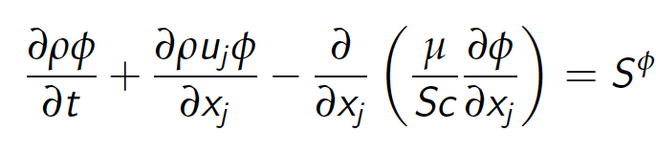
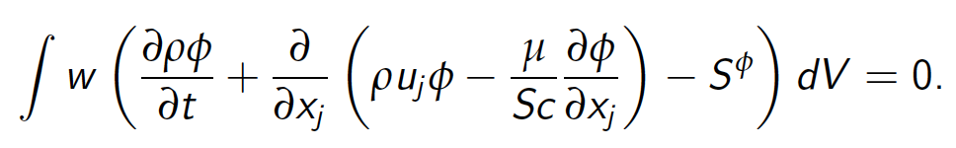
Model Passive Scalar Transport
Time/Src/Advection/Diffusion equation for scalar φ
Here, w is the weight function, or an arbitrary function that is differentiable - at least once
Any ideas why? What are the properties of the above PDE?
In this example, let density, velocity, and diffusive flux coefficient be prescribed
This equation, with a prescribed velocity, can be used to model trace species contaminant transport, smoke, etc.
The above equation is termed a weighted-residual statement of the original PDE
Thus far, it is exact

